Slide 1

IPL Data Analysis
(2008 – 2018)

Slide 2
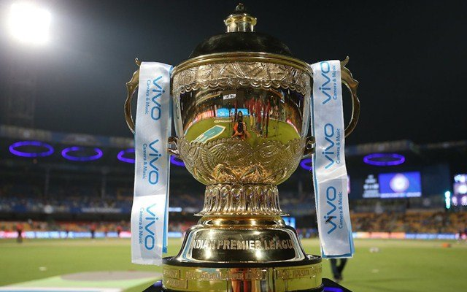
Introduction
1.1. Introduction
The Indian Premier League (IPL), officially Vivo Indian Premier League for sponsorship reasons, is a professional Twenty20 cricket league in India contested during April and May of every year by teams representing Indian cities and some states.The league was founded by the Board of Control for Cricket in India (BCCI) in 2008, and is regarded as the brainchild of Lalit Modi, the founder and former commissioner of the league. IPL has an exclusive window in ICC Future Tours Programme.
The IPL is the most-attended cricket league in the world and in 2014 ranked sixth by average attendance among all sports leagues. In 2010, the IPL became the first sporting event in the world to be broadcast live on YouTube.The brand value of IPL in 2018 was (US dollar 6.3 billion), according to Duff & Phelps. According to BCCI, the 2015 IPL season contributed ₹11.5 billion (US dollar 182 million) to the GDP of the Indian economy.
There have been eleven seasons of the IPL tournament. The current IPL title holders are the Chennai Super Kings, who won the 2018 season. The most successful franchises in the tournament are the Chennai Super Kings and Mumbai Indians with 3 tournament wins each. (*Source: Wikipedia

Slide 3
Data Information
We have received the data from the Github website. In this file we can see all the team names, venue names, city names, dates of matches, winner of the matches, etc.
Data is received from genuine source & verified with the official IPL database.

Slide 4
Glance of a Data
Column Name | Description
season | Year when tournament is held
city | In which city match was played
Date | Match date
team1 | First team name
team2 | Second team name
toss_winner | Which team won the toss
toss_decision | Number of sibling and/or spouse travelling with passenger
result | Number of parent and/or children travelling with passenger
dl_applied | Duckworth–Lewis method used for results
winner | Which team won the match
win_by_runs | which team defended the total
win_by_wickets | Which team chase the traget
player_of_match | Which player played the best to contribute more to win
venue | On which ground match was played
umpire1 | First standing Umpire name
umpire2 | Second standing Umpire name
umpire3 | Third Umpire name

Slide 5
Problem Statement
Using his dataset we are going to analayis following things:-
How many seasons we’ve got in the dataset?
Which Team had won by maximum runs?
Which Team had won by maximum wicket?
Which Season had most number of matches?
Which IPL Team is more successful?
Which player has won maximum player of the match award?
Has Toss-winning helped in winning matches?
IPL matches played in which stadiums?
Which Team is best in defending the total?
Which Team is best in chasing the target?
Which the best venue to defend the total?
Which the best venue to chase the target?
Venue wise result!
Which player received the maximum number of Player of Match award while defending the total?
Which player received the maximum number of Player of Match award while chasing the target?
Player of The Match wise results!
Venue & Player of The Match wise results!

Slide 6
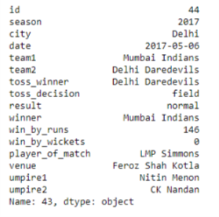
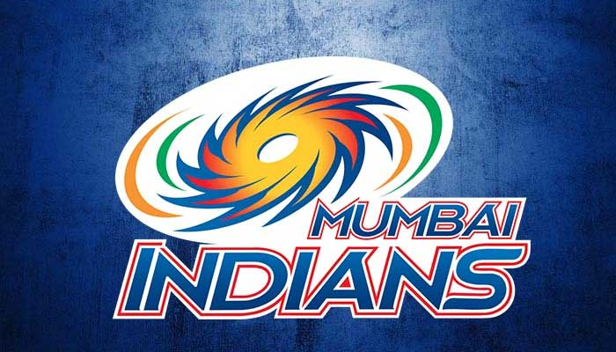
Which Team had won by maximum runs?
As of now all the match played in entire history of IPL, we have got a match which is played in 2017 season between Mumbai Indians & Delhi Daredevils where Mumbai Indians defended the score & won the match by margin of 146 runs

Slide 7
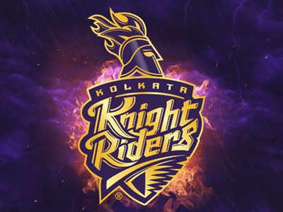
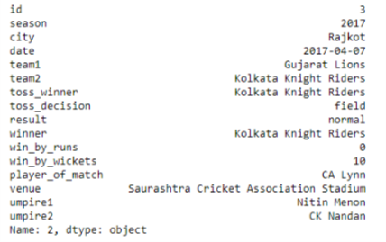
Which Team had won by maximum wicket?
As of now all the match played in entire history of IPL, we have got a match which is played in 2017 season between Gujrat Lions & Kolkata Knight Riders where Kolkata Night Riders chased the score without losing a wicket

Slide 8
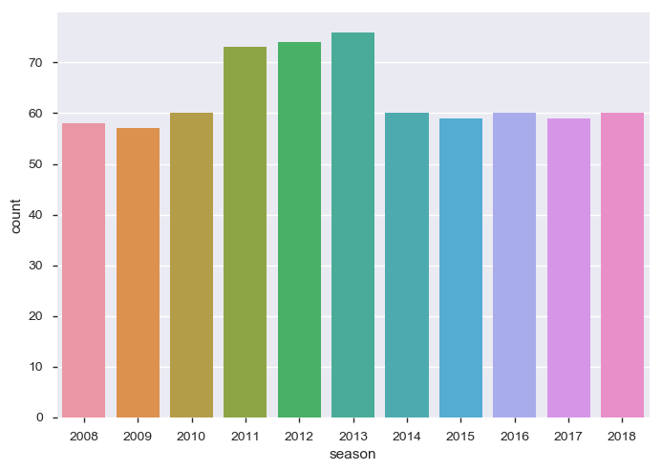
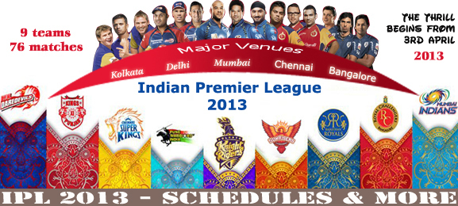
Which Season had most number of matches?
From the above graph we can see that in the season of 2013 year total 76 matches were played which is the most among all the season

Slide 9
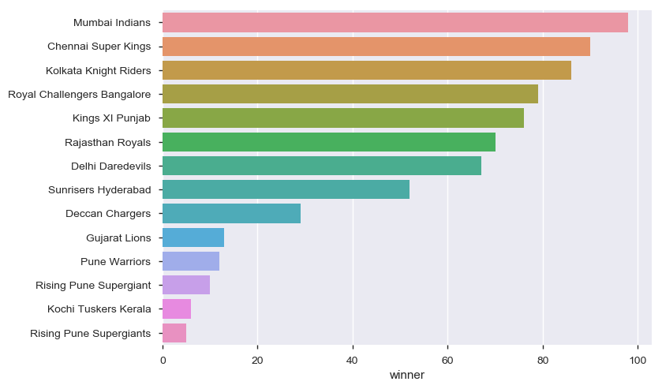
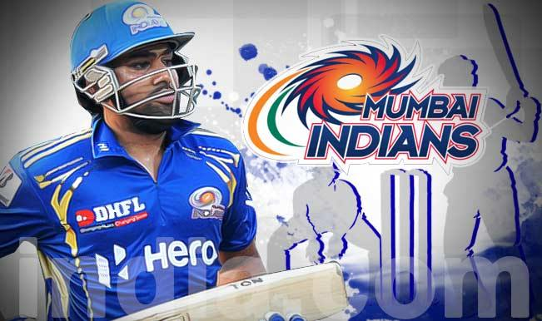
Which IPL Team is more successful?
From the above graph we can see that Mumbai Indians is most successful team among all the IPL team played in the history of IPL.

Slide 10
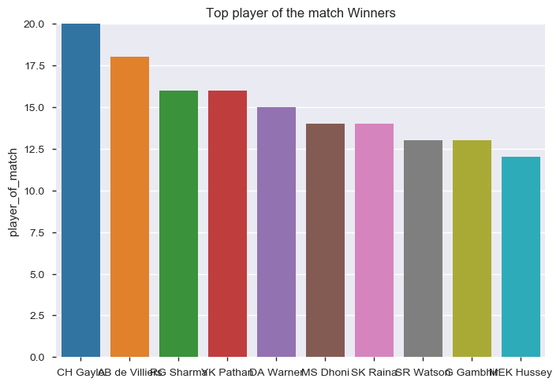
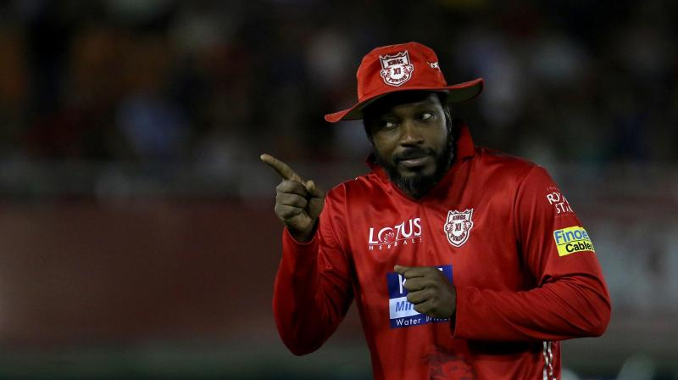
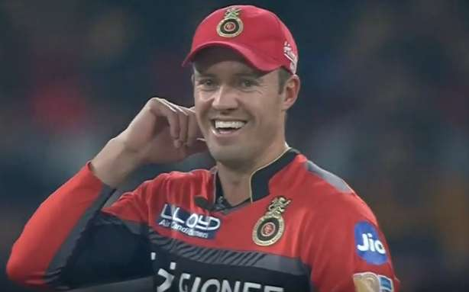
Which player has won maximum player of the match award?
From the above graph we can see that Chris Gayle has won maximum numbers of Player of The Match awards followed by AB De Villiers.

Slide 11
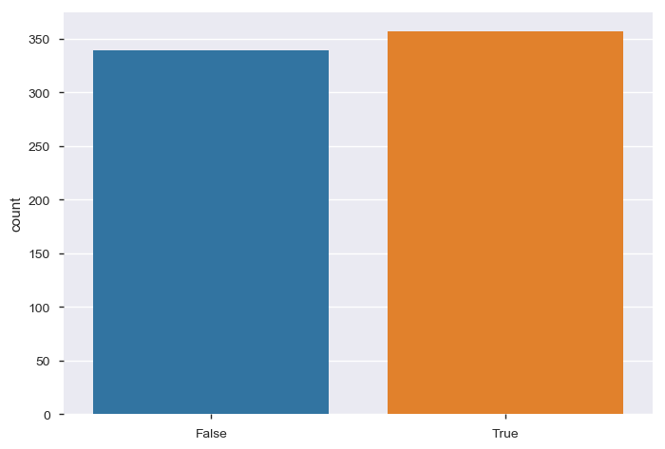

Has Toss-winning helped in winning matches?
This result shows us Toss winning has not affected end match result as result has shown almost same count

Slide 12
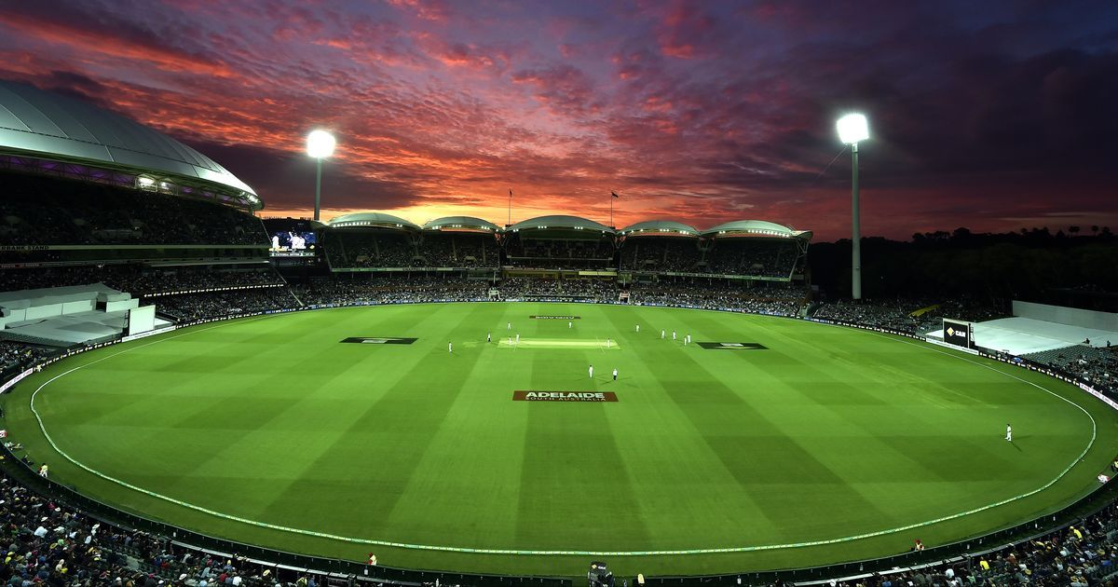
IPL matches played in which stadiums?
International Stadiums | Domestic Stadiums
Barabati Stadium | Dr DY Patil Sports Academy
Brabourne Stadium | Dr. Y.S. Rajasekhara Reddy ACA-VDCA Cricket Stadium
Buffalo Park | Eden Gardens
De Beers Diamond Oval | Feroz Shah Kotla
Dubai International Cricket Stadium | Himachal Pradesh Cricket Association Stadium
Green Park | Holkar Cricket Stadium
JSCA International Stadium Complex | M Chinnaswamy Stadium
Kingsmead | MA Chidambaram Stadium, Chepauk
New Wanderers Stadium | Maharashtra Cricket Association Stadium
Newlands | Nehru Stadium
OUTsurance Oval | Punjab Cricket Association IS Bindra Stadium, Mohali
Sharjah Cricket Stadium | Rajiv Gandhi International Stadium Uppal
Sheikh Zayed Stadium | Sardar Patel Stadium, Motera
St George's Park | Saurashtra Cricket Association Stadium
SuperSport Park | Sawai Mansingh Stadium
 | Shaheed Veer Narayan Singh International Stadium
 | Subrata Roy Sahara Stadium
 | Vidarbha Cricket Association Stadium, Jamtha
 | Wankhede Stadium

Slide 13
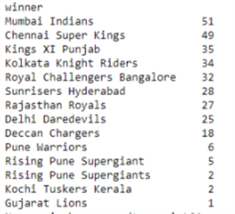
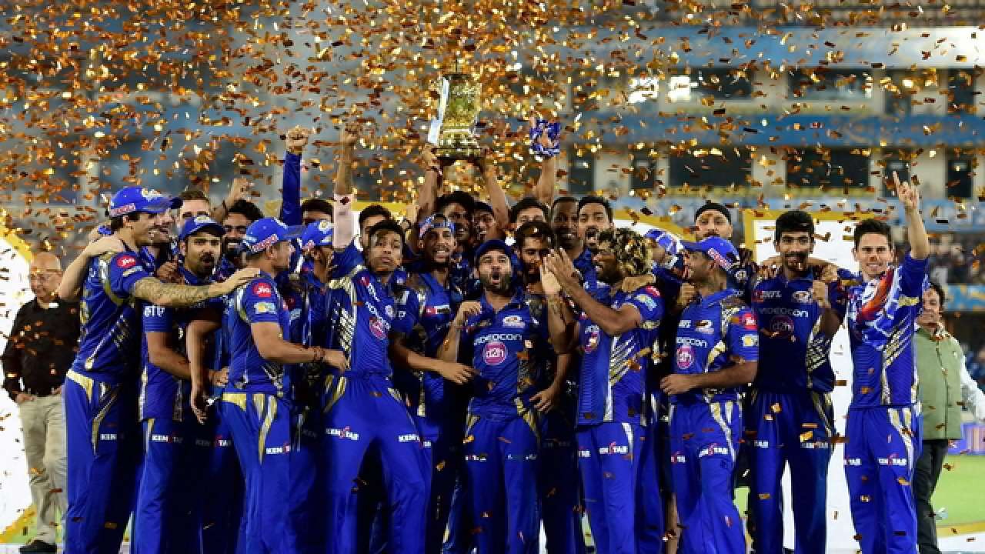
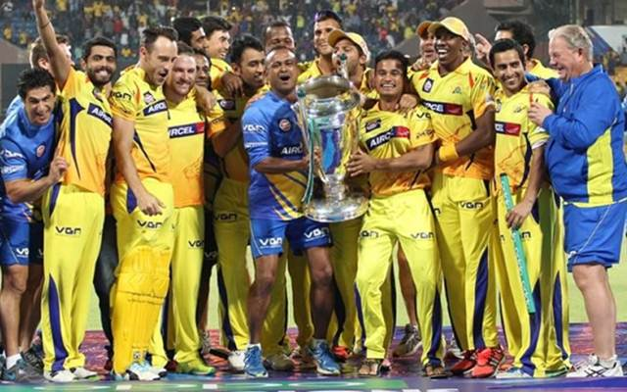
Which Team is best in defending the total?
From the above result we can see that Mumbai Indians has defended the total 51 times which is most among all other teams, followed by Chennai Super Kings 49 times & Kings XI Punjab 35 times.

Slide 14
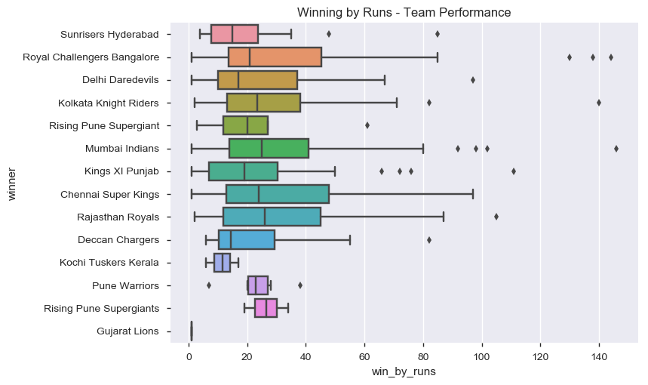
Which Team is best in defending the total?

Slide 15
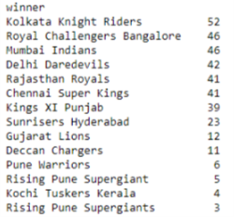
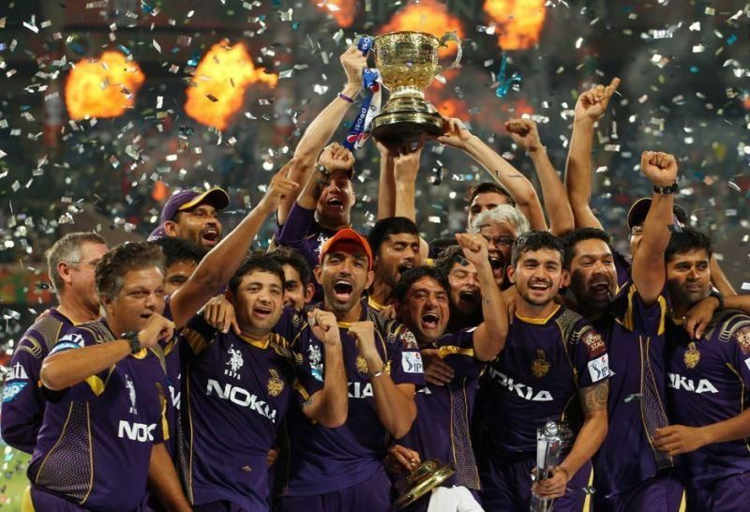
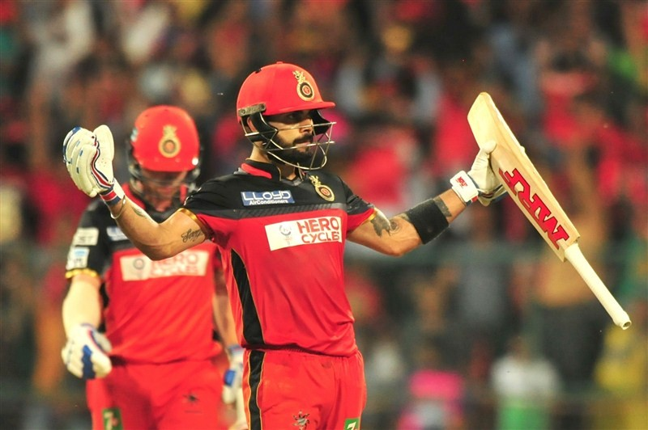
Which Team is best in chasing the target?
From the above results we can see that Kolkata Knight Riders as chased the target 52 times which is most by any team in IPL history, followed by Royal Challengers Bangalore & Mumbai Indians 46 times each.

Slide 16
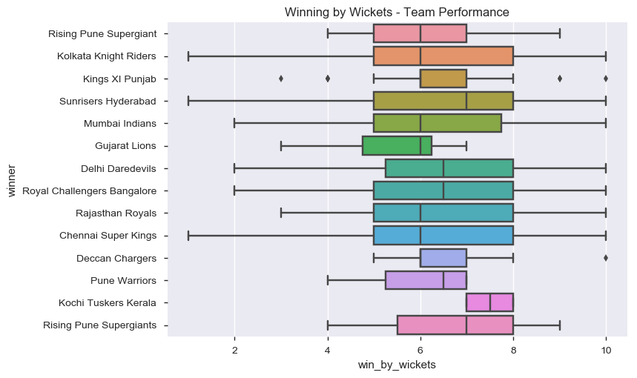
Which Team is best in chasing the target?

Slide 17
Which is the best venue to defend the total?
Venue | Nos
Wankhede Stadium | 33
Feroz Shah Kotla | 33
M Chinnaswamy Stadium | 30
MA Chidambaram Stadium, Chepauk | 30
Eden Gardens | 29
Rajiv Gandhi International Stadium, Uppal | 23
Punjab Cricket Association Stadium, Mohali | 15
Sawai Mansingh Stadium | 14
Subrata Roy Sahara Stadium | 11
Kingsmead | 9
Dr DY Patil Sports Academy | 7
Dr. Y.S. Rajasekhara Reddy ACA-VDCA Cricket Stadium | 7
Maharashtra Cricket Association Stadium | 7
Punjab Cricket Association IS Bindra Stadium, Mohali | 7
Sardar Patel Stadium, Motera | 6
Brabourne Stadium | 6
Himachal Pradesh Cricket Association Stadium | 5
Barabati Stadium | 4
Newlands | 4
SuperSport Park | 4
New Wanderers Stadium | 3
Saurashtra Cricket Association Stadium | 3
Dubai International Cricket Stadium | 3
Sheikh Zayed Stadium | 3
St George's Park | 3
Nehru Stadium | 3
Vidarbha Cricket Association Stadium, Jamtha | 2
JSCA International Stadium Complex | 2
Shaheed Veer Narayan Singh International Stadium | 2
Sharjah Cricket Stadium | 2
Buffalo Park | 2
OUTsurance Oval | 1
Holkar Cricket Stadium | 1
De Beers Diamond Oval | 1

Slide 18
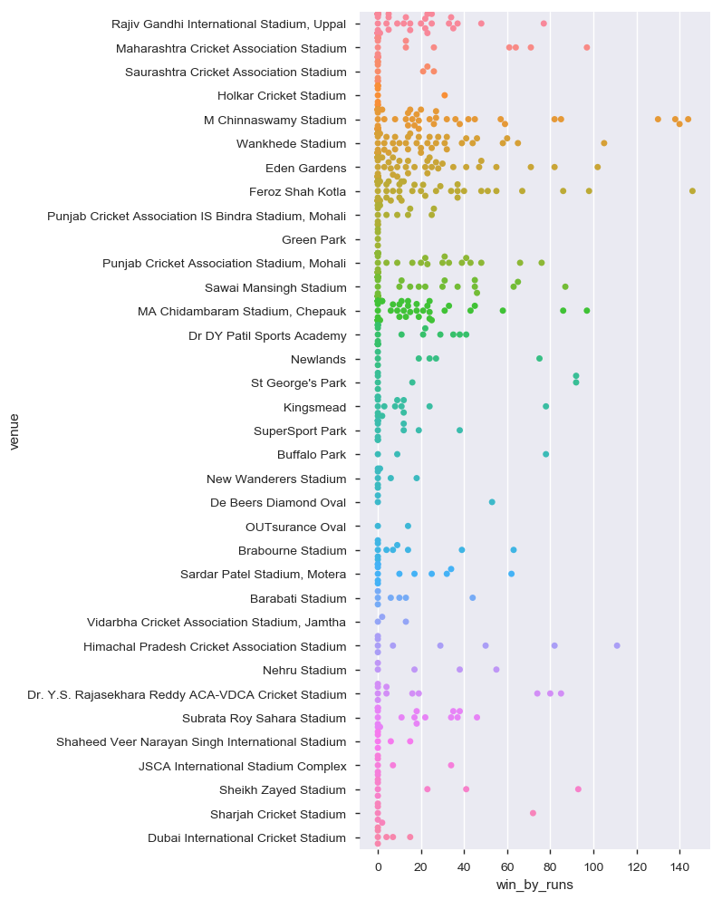
Which is the best venue to defend the total?
Wankhede Stadium and Feroz Shah Kotla are the best venue to defend the total with total 33 matches count.

Slide 19
Which is the best venue to chase the total?
Venue | Nos
Eden Gardens | 41
M Chinnaswamy Stadium | 40
Wankhede Stadium | 33
Feroz Shah Kotla | 33
Rajiv Gandhi International Stadium, Uppal | 32
Sawai Mansingh Stadium | 26
Punjab Cricket Association Stadium, Mohali | 20
MA Chidambaram Stadium, Chepauk | 18
Maharashtra Cricket Association Stadium | 14
Dr DY Patil Sports Academy | 10
SuperSport Park | 8
Holkar Cricket Stadium | 8
Punjab Cricket Association IS Bindra Stadium, Mohali | 7
Subrata Roy Sahara Stadium | 6
Saurashtra Cricket Association Stadium | 6
Kingsmead | 6
JSCA International Stadium Complex | 5
Brabourne Stadium | 5
New Wanderers Stadium | 5
Sardar Patel Stadium, Motera | 5
Himachal Pradesh Cricket Association Stadium | 4
Green Park | 4
St George's Park | 4
Dubai International Cricket Stadium | 4
Shaheed Veer Narayan Singh International Stadium | 4
Sharjah Cricket Stadium | 4
Dr. Y.S. Rajasekhara Reddy ACA-VDCA Cricket Stadium | 4
Barabati Stadium | 3
Sheikh Zayed Stadium | 3
Newlands | 2
De Beers Diamond Oval | 2
Nehru Stadium | 2
Vidarbha Cricket Association Stadium, Jamtha | 1
OUTsurance Oval | 1
Buffalo Park | 1

Slide 20
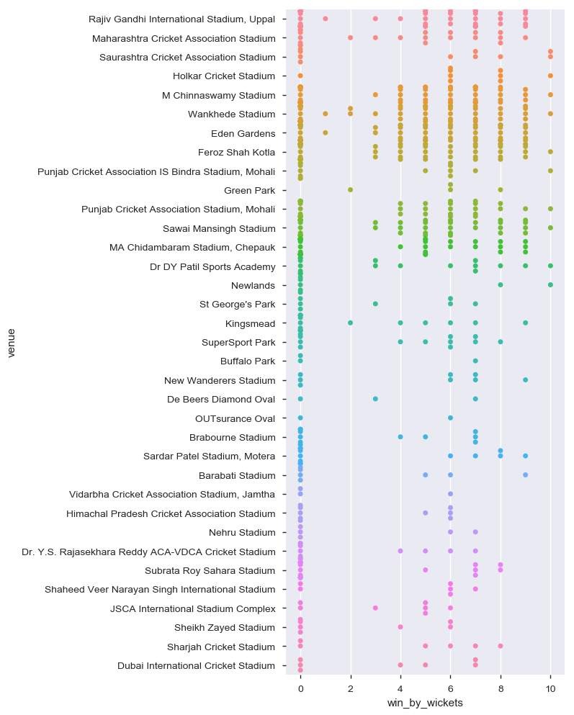
Which is the best venue to chase the total?
Eden Gardens is the best venue for chasing total 41 matches won

Slide 21
Venue wise result!
Stadium Name | win_by_runs | win_by_wickets | Total
M Chinnaswamy Stadium | 30 | 40 | 70
Eden Gardens | 29 | 41 | 70
Feroz Shah Kotla | 33 | 33 | 66
Wankhede Stadium | 33 | 33 | 66
Rajiv Gandhi International Stadium, Uppal | 23 | 32 | 55
MA Chidambaram Stadium, Chepauk | 30 | 18 | 48
Sawai Mansingh Stadium | 14 | 26 | 40
Punjab Cricket Association Stadium, Mohali | 15 | 20 | 35
Maharashtra Cricket Association Stadium | 7 | 14 | 21
Subrata Roy Sahara Stadium | 11 | 6 | 17
Dr DY Patil Sports Academy | 7 | 10 | 17
Kingsmead | 9 | 6 | 15
Punjab Cricket Association IS Bindra Stadium, Mohali | 7 | 7 | 14
SuperSport Park | 4 | 8 | 12
Dr. Y.S. Rajasekhara Reddy ACA-VDCA Cricket Stadium | 7 | 4 | 11
Brabourne Stadium | 6 | 5 | 11
Sardar Patel Stadium, Motera | 6 | 5 | 11
Himachal Pradesh Cricket Association Stadium | 5 | 4 | 9
Saurashtra Cricket Association Stadium | 3 | 6 | 9
Holkar Cricket Stadium | 1 | 8 | 9
New Wanderers Stadium | 3 | 5 | 8
Barabati Stadium | 4 | 3 | 7
Dubai International Cricket Stadium | 3 | 4 | 7
St George's Park | 3 | 4 | 7
JSCA International Stadium Complex | 2 | 5 | 7
Newlands | 4 | 2 | 6
Sheikh Zayed Stadium | 3 | 3 | 6
Shaheed Veer Narayan Singh International Stadium | 2 | 4 | 6
Sharjah Cricket Stadium | 2 | 4 | 6
Nehru Stadium | 3 | 2 | 5
Green Park | 0 | 4 | 4
Buffalo Park | 2 | 1 | 3
Vidarbha Cricket Association Stadium, Jamtha | 2 | 1 | 3
De Beers Diamond Oval | 1 | 2 | 3
OUTsurance Oval | 1 | 1 | 2

Slide 22
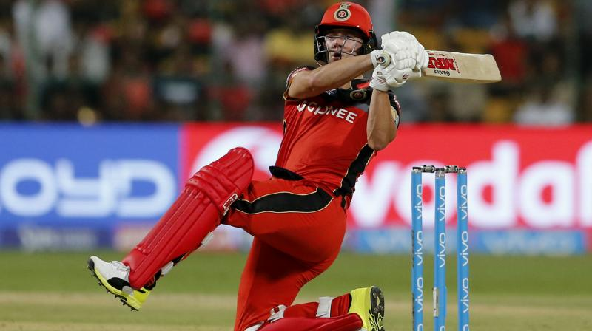
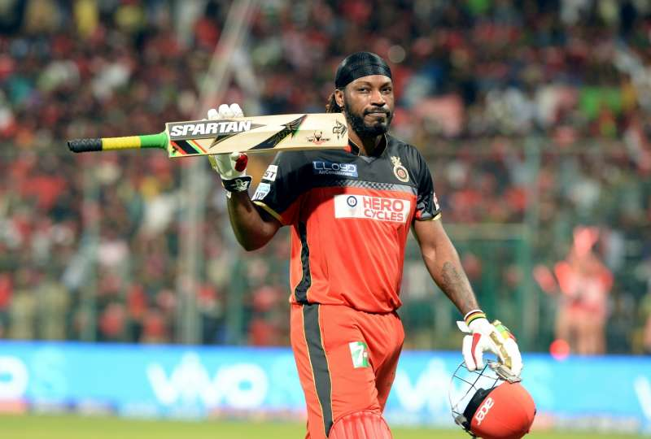
Which player received the maximum number of Player of Match award while defending the total?
player_of_match | Nos.
AB de Villiers | 11
CH Gayle | 10
SK Raina | 9
DA Warner | 8
MEK Hussey | 8
MS Dhoni | 7
RG Sharma | 7
KA Pollard | 7
A Mishra | 6
AT Rayudu | 5
SR Tendulkar | 5
SR Watson | 5
SC Ganguly | 5
AM Rahane | 5

Slide 23
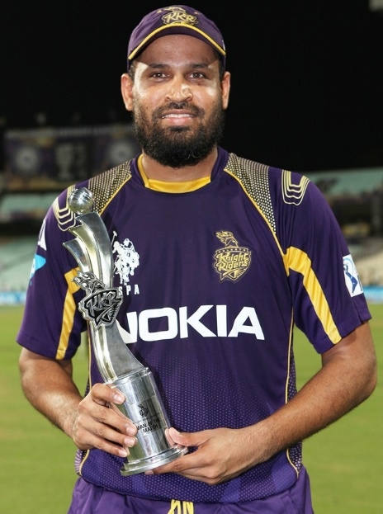
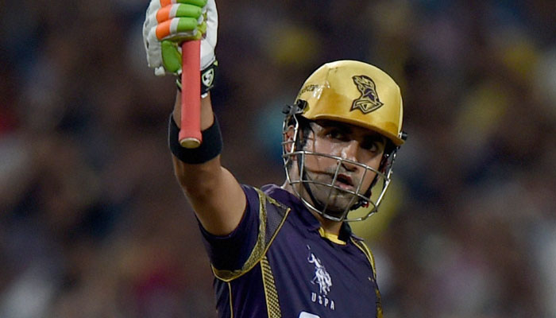
Which player received the maximum number of Player of Match award while chasing the target?
player_of_match | Nos.
YK Pathan | 11
G Gambhir | 10
RG Sharma | 9
CH Gayle | 9
JH Kallis | 8
DR Smith | 8
DA Warner | 7
MS Dhoni | 7
V Sehwag | 7
V Kohli | 7
AB de Villiers | 7
SR Watson | 7
AM Rahane | 7
UT Yadav | 6
AC Gilchrist | 5
SK Raina | 5
SP Narine | 5

Slide 24
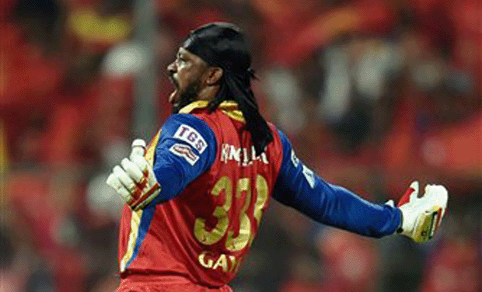
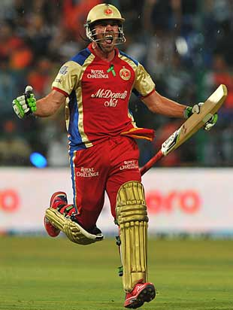
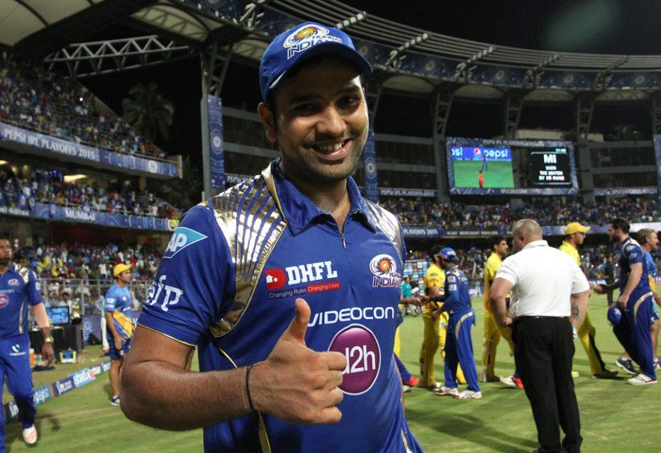
Player of the Match - Match wise result
Players Name | win_by_runs | win_by_wickets | Total
CH Gayle | 10 | 9 | 19
AB de Villiers | 11 | 7 | 18
RG Sharma | 7 | 9 | 16
DA Warner | 8 | 7 | 15
YK Pathan | 4 | 11 | 15
MS Dhoni | 7 | 7 | 14
SK Raina | 9 | 5 | 14
G Gambhir | 3 | 10 | 13
AM Rahane | 5 | 7 | 12
MEK Hussey | 8 | 4 | 12
SR Watson | 5 | 7 | 12
A Mishra | 6 | 4 | 10
DR Smith | 2 | 8 | 10
JH Kallis | 2 | 8 | 10
V Kohli | 3 | 7 | 10
V Sehwag | 3 | 7 | 10
AT Rayudu | 5 | 4 | 9
KA Pollard | 7 | 2 | 9
RA Jadeja | 4 | 4 | 8
SP Narine | 3 | 5 | 8
SR Tendulkar | 5 | 3 | 8
UT Yadav | 2 | 6 | 8

Slide 25
Venue & Player of The Match wise results
Stadium Name | count | unique | Player Name | freq
M Chinnaswamy Stadium | 71 | 44 | CH Gayle | 9
Rajiv Gandhi International Stadium, Uppal | 56 | 37 | DA Warner | 7
Wankhede Stadium | 66 | 45 | RG Sharma | 7
Eden Gardens | 70 | 44 | SP Narine | 6
MA Chidambaram Stadium, Chepauk | 49 | 32 | MEK Hussey | 5
Punjab Cricket Association Stadium, Mohali | 35 | 26 | SE Marsh | 5
Feroz Shah Kotla | 66 | 51 | A Mishra | 4
Sawai Mansingh Stadium | 40 | 29 | AM Rahane | 4
Barabati Stadium | 7 | 6 | A Symonds | 2
Brabourne Stadium | 11 | 10 | SR Tendulkar | 2
Dr DY Patil Sports Academy | 17 | 15 | DE Bollinger | 2
Himachal Pradesh Cricket Association Stadium | 9 | 8 | AC Gilchrist | 2
JSCA International Stadium Complex | 7 | 6 | RA Jadeja | 2
Maharashtra Cricket Association Stadium | 21 | 18 | AB de Villiers | 2
New Wanderers Stadium | 8 | 7 | JH Kallis | 2
Punjab Cricket Association IS Bindra Stadium, Mohali | 14 | 13 | CH Gayle | 2
Sardar Patel Stadium, Motera | 12 | 11 | AM Rahane | 2
Shaheed Veer Narayan Singh International Stadium | 6 | 5 | DA Warner | 2
Sharjah Cricket Stadium | 6 | 5 | GJ Maxwell | 2

Slide 26
Conclusion
Cricket one of the most loved and favourite sports entertainment specially in India. Here I present data analysis for IPL (Indian Premier League) matches from the beginning till year 2018. This can be useful for all the cricket lovers to analyse and made quick decisions based out from this. Few of which can be like; Which cricketer has scored the most for a particular season? few of which can be toss decision and venue of the match played ! Various visual along with custom one have been used with filters and drill down capability.
Also it will addresses the player profiling system which can be a great help for the team leaders. The statistics of 644 matches have been used in the experiments.

Slide 27


